Slide 1



Bases de données complexes et nouveaux outils prédictifs: - MIMIC-II - Super ICU Learner Algorithm (SICULA) Project
PIRRACCHIO R, Petersen M, Carone M, Resche Rigon M, Chevret S and van der Laan M
Division of Biostatistics, UC Berkeley, USA
Département de Biostatistiques et informatique Médicale, UMR-717, Paris, France
Service d’Anesthésie-Réanimation, HEGP, Paris

Slide 2
The Data

Slide 3
Upcoming Medical Data
« Big data »
p >>> n
Génomic, radiomic, …
I2B2 data centers:
Informatics for Integrating Biology & Bedside
Boston: MIT – Harvard
=> New Statistical Challenges

Slide 4
MIMIC-II
Publically available dataset including all patients admitted to an ICU at the Beth Israel Deaconess Medical Center (BIDMC) in Boston, MA :
medical (MICU), trauma-surgical (TSICU), coronary (CCU), cardiac surgery recovery (CSRU) and medico-surgical (MSICU) critical care units.
Data collection started in 2001
Patient recruitment is still ongoing.
Patients charts, beat-by-beat waveform signal, biology, notes ….
Lee, Conf Proc IEEE Eng Med Biol Soc 2011
Saeed, Crit Care Med 2011

Slide 5
MIMIC-II
Access to the Clinical Database:
On-line course on protecting human research participants (minimum 3 hours)
For all participants
Basic Access Web interface :
Requires knowledge of SQL
User friendly for databases specialists
Limited size of the data export
Root data export (.txt) (20Go)

Slide 6
Adapted Prediction Algorithms
We need new models for ICU mortality prediction !

Slide 7
Motivations for Mortality Prediction
Improved mortality prediction for ICU patients in remains an important challenge:
Clinical research: stratification/adjustment on patients’ severity
ICU care: adaptation of the level of care/monitoring; choice of the appropriate structure
Health policies: performance indicators

Slide 8
Currently used Scores
SAPS, APACHE, MPM, LODS, SOFA,…
And several updates for each of them
The most widely in practice are:
The SAPS II score in Europe
Le Gall, JAMA 1993
The APACHE II score in the US
Knauss, Crit Care Med 1985
Notes:
Pourquoi est-ce un problème?
Pour startifier pb
Evaluation des ICU basées sur le SMR…. Directement liés à la calibration

Slide 9
Currently used Scores
SAPS, APACHE, MPM, LODS, SOFA,…
And several updates for each of them
The most widely in practice are:
The SAPS II score in Europe
Le Gall, JAMA 1993
The APACHE II score in the US
Knauss, Crit Care Med 1985
PROBLEM: fair discrimination but poor calibration
Notes:
Pourquoi est-ce un problème?
Pour startifier pb
Evaluation des ICU basées sur le SMR…. Directement liés à la calibration

Slide 10
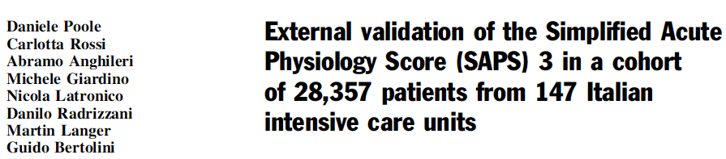
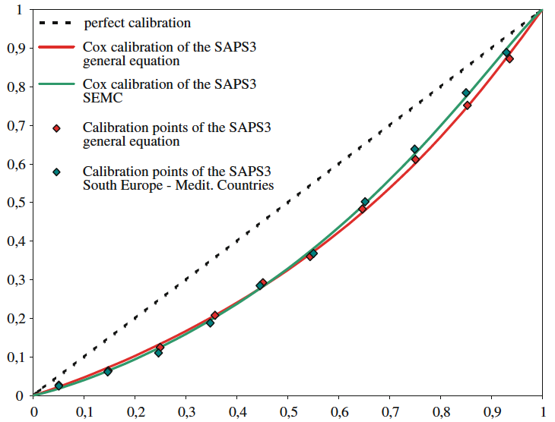
Notes:
J’ajouterais les labels des axes car par certains que beaucoup de gens soient familier avec la calibration

Slide 11
Why are the current scores performing that bad ?
4 potential reasons for that:
Global decrease of ICU mortality
Covariate selection
Geographical disparities
Parametric Logistic regression
=> Which means we acknowledge assuming a linear relationship between the outcome and the covariates
Notes:
J’ajouterai une 3ème les scores sont vieux…. La mortalité a changé et heureusement

Slide 12
Why are the current scores performing that bad ?
WHY would we accept that ???
We have alternatives !
Data-adaptive machine techniques
Non-parametric modelling algorithms

Slide 13
Super Learner
Method to choose the optimal regression algorithm among a set of (user-supplied) candidates, both parametric regression models and data-adaptive algorithms (SL Library)
Selection strategy relies on estimating a risk associated with each candidate algorithm based on:
loss-function (=risk associated with each prediction method)
V-fold cross-validation
Discrete Super Learner : select the best candidate algorithm defined as the one associated with the smallest cross-validated risk and reruns on full data for the final prediction model
Super Learner convex combination: weighted linear combination of the candidate learners where the weights are proportional to the risks.
van der Laan, Stat Appl Genet Mol Biol 2007

Slide 14
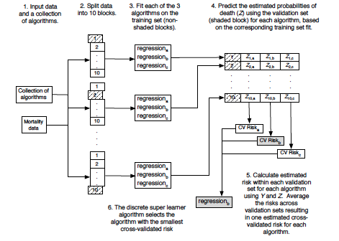
Discrete Super Learner (or Cross-validated Selector)
van der Laan, Targeted Learning, Springer 2011

Slide 15
Discrete Super Learner
The discrete SL can only do as well as the best algorithm included in the library
Not bad, but….
We can do better than that !

Slide 16
Super Learner
Method to choose the optimal regression algorithm among a set of (user-supplied) candidates, both parametric regression models and data-adaptive algorithms (SL Library)
Selection strategy relies on estimating a risk associated with each candidate algorithm based on:
loss-function
V-fold cross-validation
Discrete Super Learner : select the best candidate algorithm defined as the one associated with the smallest cross-validated risk and reruns on full data for the final prediction model
Super Learner convex combination: weighted linear combination of the candidate learners where the weights weights themselves are fitted data-adapvely using Cross-validation to give the best overall fit
van der Laan, Stat Appl Genet Mol Biol 2007

Slide 17
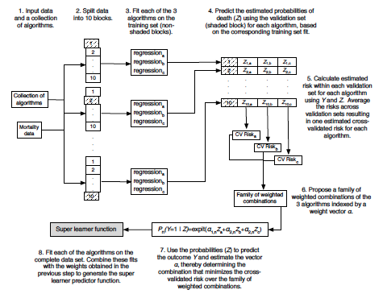
Discrete Super Learner (or Cross-validated Selector)
van der Laan, Targeted Learning, Springer 2011

Slide 18
Asymptotical Properties
The combination has Oracle properties:
Performs asymptotically at least as well as the best choice among the library of candidate algorithms if the library does not contain a correctly specified parametric model
Achieves the same rate of convergence as the correctly specified parametric model otherwise
van der Laan, Stat Appl Genet Mol Biol 2007

Slide 19
Results

Slide 21
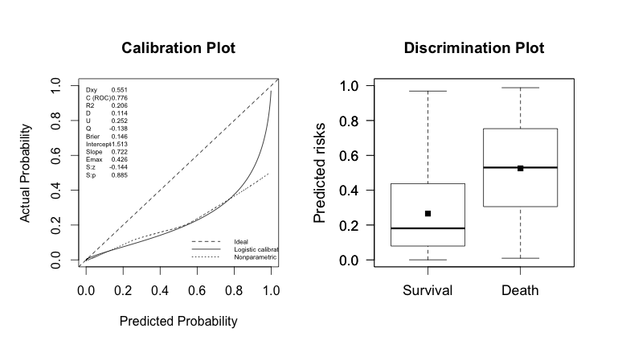
SAPS II

Slide 22
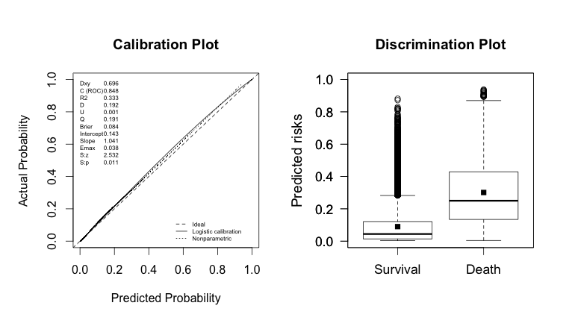
SAPS II
Super Learner 1

Slide 23
Super Learner 1

Slide 24
Super Learner 2

Slide 25
Conclusion
I2B2: new exciting perspective for clinical research
Need to get rid of “old good” regression methods !
As compared to conventional severity scores, our Super Learner-based proposal offers improved performance for predicting hospital mortality in ICU patients.
The score will evoluate together with
New observations
New explanatory variables
SICULA : Just play with it !!
http://webapps.biostat.berkeley.edu:8080/sicula/

Slide 26
